Slide 1
Long Short Term memory(LSTM) and GAN(

Slide 2
Neural Network classified in two part
CNN(RCNN,FAST RCNN,FASTER RCNN, YOLO)
RNN[(Long Short Term memory)LSTM, Gated Recurrent Unit(GRU) BIGRU]
GAN can use CNN and RNN based on application

Slide 3
The Problem in RNN : Short-term Memory
Recurrent Neural Networks suffer from short-term memory.
If a sequence is long enough, they’ll have a hard time carrying information from earlier time steps to later ones.
So if you are trying to process a paragraph of text to do predictions, RNN’s may leave out important information from the beginning.
During back propagation, recurrent neural networks suffer from the vanishing gradient problem. Gradients are values used to update a neural networks weights. The vanishing gradient problem is when the gradient shrinks as it back propagates through time. If a gradient value becomes extremely small, it doesn’t contribute too much learning.So in recurrent neural networks, layers that get a small gradient update stops learning. Those are usually the earlier layers. So because these layers don’t learn, RNN’s can forget what it seen in longer sequences, thus having a short-term memory

Slide 4
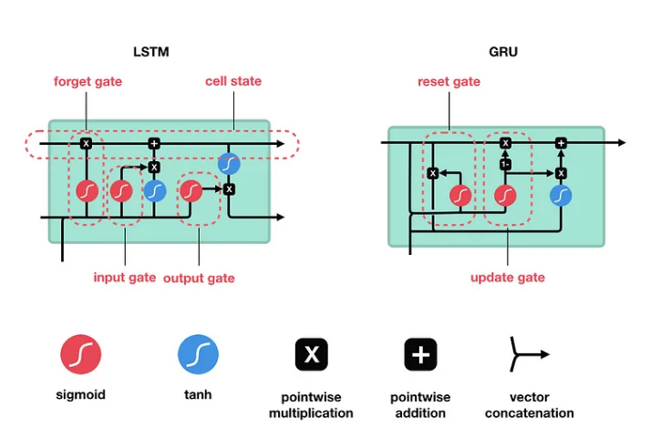

Slide 5
Review of Recurrent Neural Networks
To understand how LSTM’s or GRU’s achieves this, let’s review the recurrent neural network. An RNN works like this; First words get transformed into machine-readable vectors. Then the RNN processes the sequence of vectors one by one.
Processing sequence one by one

Slide 6
RNN
Passing hidden state to next time step
While processing, it passes the previous hidden state to the next step of the sequence.
The hidden state acts as the neural networks memory. It holds information on previous data the network has seen before.

Slide 7
RNN
Tanh activation(States)
The tanh activation is used to help regulate the values flowing through the network. The tanh function squishes values to always be between -1 and 1.
RNN Cell
First, the input and previous hidden state are combined to form a vector.
That vector now has information on the current input and previous inputs.
The vector goes through the tanh activation, and the output is the new hidden state, or the memory of the network.

Slide 8
RNN: need of Tanh activation function
vector transformations without tanh
When vectors are flowing through a neural network, it undergoes many transformations due to various math operations. So imagine a value that continues to be multiplied by let’s say 3. You can see how some values can explode and become astronomical, causing other values to seem insignificant.
A tanh function ensures that the values stay between -1 and 1, thus regulating the output of the neural network
vector transformations with tanh

Slide 9
Core Concept of LSTM
The core concept of LSTM’s are the cell state, and it’s various gates.
The cell state act as a transport highway that transfers relative information all the way down the sequence chain. You can think of it as the “memory” of the network.
As the cell state goes on its journey, information get’s added or removed to the cell state via gates.
The gates are different neural networks that decide which information is allowed on the cell state.
The gates can learn what information is relevant to keep or forget during training.

Slide 10
Sigmoid Activation function
Gates contains sigmoid activations.
A sigmoid activation is similar to the tanh activation.
Instead of squishing values between -1 and 1, it squishes values between 0 and 1.
That is helpful to update or forget data because any number getting multiplied by 0 is 0, causing values to disappears or be “forgotten.” Any number multiplied by 1 is the same value therefore that value stay’s the same or is “kept.” The network can learn which data is not important therefore can be forgotten or which data is important to keep.
Sigmoid squishes values to be between 0 and 1

Slide 11

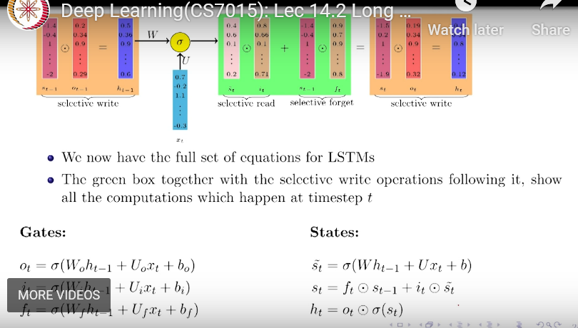

Forget gate
First, is the forget gate.
This gate decides what information should be thrown away or kept.
Information from the previous hidden state and information from the current input is passed through the sigmoid function.
Values come out between 0 and 1. The closer to 0 means to forget, and the closer to 1 means to keep.
forget gate
s(t-1)
Pre state
Cell state
h(t-1)*Wf
Hidden state
x(t)*Uf

Slide 12
Input Gate
The need of Input gate is to update the cell state.
Pass the previous hidden state and current input into a sigmoid function to transform the values between 0 and 1. 0 means not important, and 1 means important.
Pass the hidden state and current input into the tanh function to squish values between -1 and 1 to help regulate the network.
multiply the tanh output with the sigmoid output. The sigmoid output will decide which information is important to keep from the tanh output.
I/P gate
Curr temp state

Slide 13

Cell State
First, the previous cell state gets pointwise multiplied by the forget vector.
This has a possibility of dropping values in cell state if it gets multiplied by values near 0.
Then we take the output from the input gate and do a pointwise addition which updates the cell state to new values that the neural network finds relevant.
That gives us our new cell state.
Calculating cell state

Slide 14
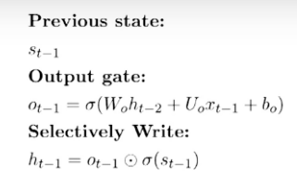
Output Gate
The output gate decides what the next hidden state should be.
Remember that the hidden state contains information on previous inputs.
First, we pass the previous hidden state and the current input into a sigmoid function.
Then we pass the newly modified cell state to the tanh function.
We multiply the tanh output with the sigmoid output to decide what information the hidden state should carry.
The output is the hidden state. The new cell state and the new hidden is then carried over to the next time step.
New state st+1
St
st-1
ht-1
New hidden state ht+1
o/p gate

Slide 15
Intuition: How gates help to solve the problem of vanishing gradients: During forward propagation, gates control the flow of the information. They prevent any irrelevant information from being written to the state.Similarly, during backward propagation, they control the flow of the gradients. It is easy to see that during the backward pass, gradients will get multiplied by the gate.
ht = (st)*(ot) (Equation 1)
Now let’s say we wish to compute the derivative of the Loss function with respect to W, now in that derivative, at some point we would encounter the derivative of this (ht) with respect to (st) (as we would be back-propagating and ht is derived as the multiplication of st with some numbers(st is multiplied with the ot gate)). And this derivative of (ht) with respect to (st) would just be (ot) as is clear from equation 1. So, that means somewhere in the chain of derivative, (while computing the derivative of the Loss function with respect to W) we would have multiplication with this (ot).

Slide 16
Just as in the forward propagation, things are being multiplied by gates and these gates decides in a way how much of information it needs to pass, during backward propagation also, the gradients are getting multiplied by gates and these gates control the backward flow of information because this gradient is deciding how much of this gradient needs to flow back

Slide 18
GANs are used in more demanding tasks like super-resolution, and image-to-image translation, while VAEs are widely used in image denoising and generation.
In general generative models are used in a wide variety of real-world applications.
VAEs are used in image generation, natural language processing, and anomaly detection. As they are able to learn complicated patterns of data, they can easily distinguish anomalies in it and identify potential frauds.
They have also proven useful in medical datasets by detecting anomalies such as tumors and diseases.
On the other hand, GANs focus primarily on image generation by producing images that are identical to the original one with high resolution.
They can also be useful in audio and text generation and create never before seen audio and text. Moreover, GANs are applicable in image editing and data augmentation.

Slide 19
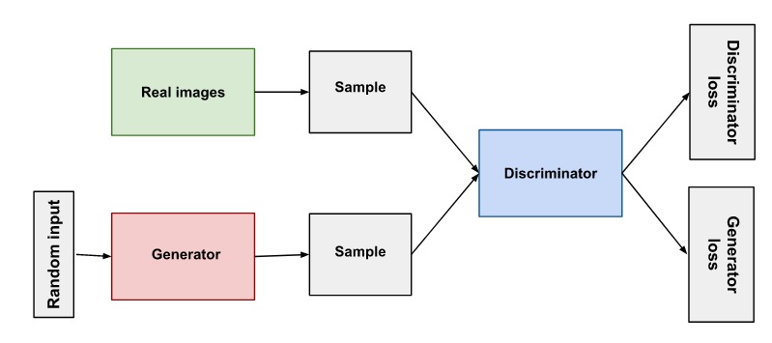
A generative adversarial network (GAN) has two parts:
The generator learns to generate plausible data. The generated instances become negative training examples for the discriminator.
The discriminator learns to distinguish the generator's fake data from real data. The discriminator penalizes the generator for producing implausible results.
When training begins, the generator produces obviously fake data, and the discriminator quickly learns to tell that it's fake
Simply, for getting a powerful hero (generator), we need a more powerful opponent (discriminator)!
https://youtu.be/uyuYfTMHZM0
https://youtu.be/1ju4qmdtRdY

Slide 20
Generative modeling :is an unsupervised learning task in machine learning that involves automatically discovering and learning the regularities or patterns in input data in such a way that the model can be used to generate or output new examples that plausibly could have been drawn from the original dataset.
GANs are a clever way of training a generative model by framing the problem as a supervised learning problem with two sub-models: the generator model that we train to generate new examples, and the discriminator model that tries to classify examples as either real (from the domain) or fake (generated).
The two models are trained together in a zero-sum game, adversarial, until the discriminator model is fooled about half the time, meaning the generator model is generating plausible examples.

Slide 21
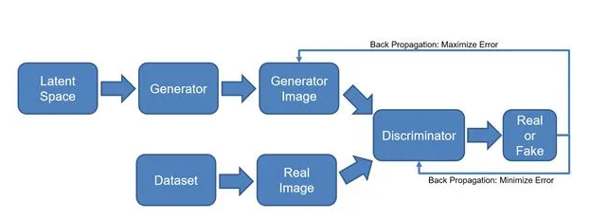
Generative Adversarial Networks (GANs), There are several advantages to using this architecture:
it generalizes with limited data, conceives new scenes from small datasets, and makes simulated data look more realistic.
These are important topics in deep learning because many techniques today require large amounts of data.
Using this new architecture, it’s possible to drastically reduce the amount of data needed to complete these tasks.
In extreme examples, these types of architectures can use 10% of the data needed for other types of deep learning problems.

Slide 22
(generator) goal: Produce products so that the cop cannot distinguish between the real and fake ones
Maximize the likelihood that the discriminator misclassifies its output as real
GANs consist of two Artificial Neural Networks or Convolution Neural Networks models namely Generator and Discriminator which are trained against each other (and thus Adversarial)
(discriminator) goal:
1.Detect anomalous products by using prior experience to classify real and fake products
2.Optimize toward a goal of 0.5, where the discriminator can’t distinguish between real and generated images
In the GAN framework, the generator will start to train alongside the discriminator; the discriminator needs to train for a few epochs prior to starting the adversarial training as the discriminator will need to be able to actually classify images

Slide 23
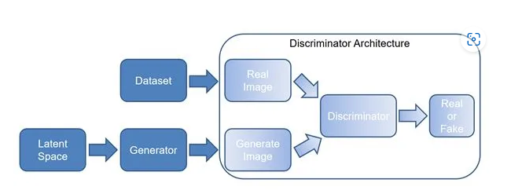
Here are a few steps to illustrate how we would build a discriminator:
First, we’ll create a convolutional neural network to classify real or fake (binary classification)
We’ll create a dataset of real data and we’ll use our generator to create fake dataset
We train the discriminator model on the real and fake data
We’ll learn to balance training of the discriminator with the generator training — if the discriminator is too good, the generator will diverge

Slide 24
Why were GANs developed in the first place?
It has been noticed most of the mainstream neural nets can be easily fooled into misclassifying things by adding only a small amount of noise into the original data.
Surprisingly, the model after adding noise has higher confidence in the wrong prediction than when it predicted correctly.
The reason for such an adversary is that most machine learning models learn from a limited amount of data, which is a huge drawback, as it is prone to overfitting.
Also, the mapping between the input and the output is almost linear.
Although, it may seem that the boundaries of separation between the various classes are linear, but in reality, they are composed of linearities, and even a small change in a point in the feature space might lead to the misclassification of data.
Abstraction is defined as dealing with ideas instead of events. In the context of AI, that means worrying more about what the right algorithm is and less about how to implement it. Another way of looking at it, for those technically inclined, is as an API call (abstracted) vs.
Abstraction separates ideas from specific instances of those ideas. To handle complex tasks, like finding new mathematical proofs, neural networks will need to form abstractions.

Slide 25
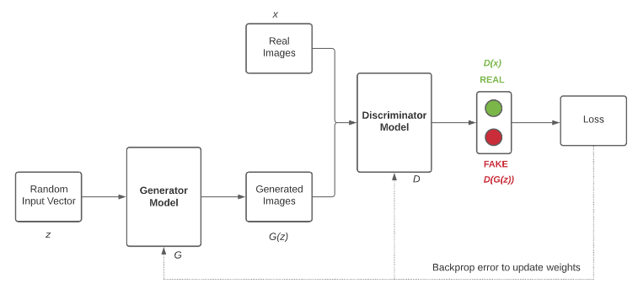
The Generator Model G takes a random input vector z as an input and generates the images G(z). These generated images along with the real images x from training data are then fed to the Discriminator Model D. The Discriminator Model then classifies the images as real or fake. Then, we have to measure the loss and this loss has to be back propagated to update the weights of the Generator and the Discriminator.
When we are training the Discriminator, we have to freeze the Generator and back propagate errors to only update the Discriminator.
When we are training the Generator, we have to freeze the Discriminator and back propagate errors to only update the Generator.

Slide 26
https://youtu.be/CIua95jUD_I
https://youtu.be/aircAruvnKk
Naive Bayes is an example of a generative model that is more often used as a discriminative model.
For example, Naive Bayes works by summarizing the probability distribution of each input variable and the output class. When a prediction is made, the probability for each possible outcome is calculated for each variable, the independent probabilities are combined, and the most likely outcome is predicted. Used in reverse, the probability distributions for each variable can be sampled to generate new plausible (independent) feature values.
Other examples of generative models include Latent Dirichlet Allocation, or LDA, and the Gaussian Mixture Model, or GMM.
Deep learning methods can be used as generative models. Two popular examples include the Restricted Boltzmann Machine, or RBM, and the Deep Belief Network, or DBN.
Two modern examples of deep learning generative modeling algorithms include the Variational Autoencoder, or VAE, and the Generative Adversarial Network, or GAN

Slide 27
Summary
The main differences between GAN and VAE are1234:
GAN is capable of producing more realistic and diverse samples than VAE, though it is more difficult to train and prone to mode collapse.
VAE can produce smoother and more coherent samples than GAN, but it tends to generate blurrier and less diverse samples due to the noise added by the decoder.
GAN seeks to match the pixel level distribution rather than the data distribution, and it optimizes the model distribution to the genuine distribution in a different method.
GANs tend to be more widely used for generating multimedia, while VAEs see more use in signal analysis
First of all, one of the key differences between VAEs and GANs lies in their training approach, as VAEs’ training follows an unsupervised approach in contrast with GANs that follow a supervised technique
During their training phase VAEs aim to maximize the probability of the generated output with respect to the input and produce an output from a target distribution by compressing the input into a latent space. On the other hand, GANs try to find the balance point between the generator’s and discriminator’s two-player game in which the first tries to deceive the second one. In addition, VAE’s loss function is KL-divergence, while a GAN uses two loss functions, the generator’s and discriminator’s loss, respectively.

